Slide 1

调整你的Linux Box，而不仅仅是PostgreSQL

Slide 2


Tune your Linux Box, not just PostgreSQL
Linux Kernel Tuning for PostgreSQL performance
Ibrar Ahmed
Senior Database Architect - Percona LLC
July 03 – 06, 2019

Slide 3
Database Performance
Hardware
Operating System (Linux)
Database (PostgreSQL) Configuration
Workload
Queries Tuning
Application Tuning

Slide 4
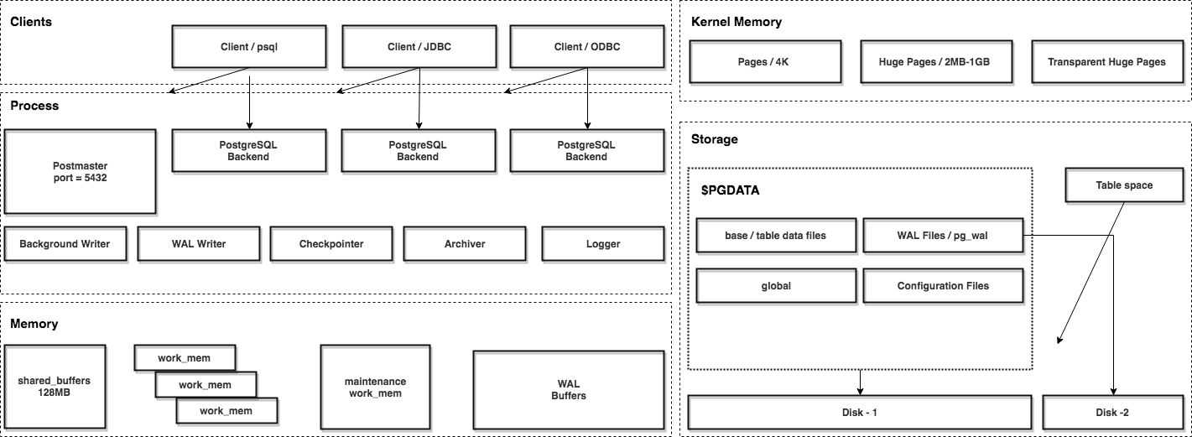
PostgreSQL Tuning

Slide 5
PostgreSQL Performance Tuning

Slide 6
PostgreSQL Tuning - Configuration Parameter
shared_buffer
wal_buffers
effective_cache_size
work_mem
maintenance_work_mem
synchronous_commit
checkpoint_timeout
checkpoint_completion_target

Slide 7
PostgreSQL Tuning / shared_buffer
PostgreSQL uses its own buffer and also uses kernel buffered I/O.
PostgreSQL buffer is called shared_buffer.
Data is written to shared_buffer then kernel buffer then on the disk.
postgresql=# SHOW shared_buffers;
shared_buffers
----------------
128MB
(1 row)
The proper size for the POSTGRESQL shared buffer cache is the largest useful size that does not adversely affect other activity.
—Bruce Momjian

Slide 8
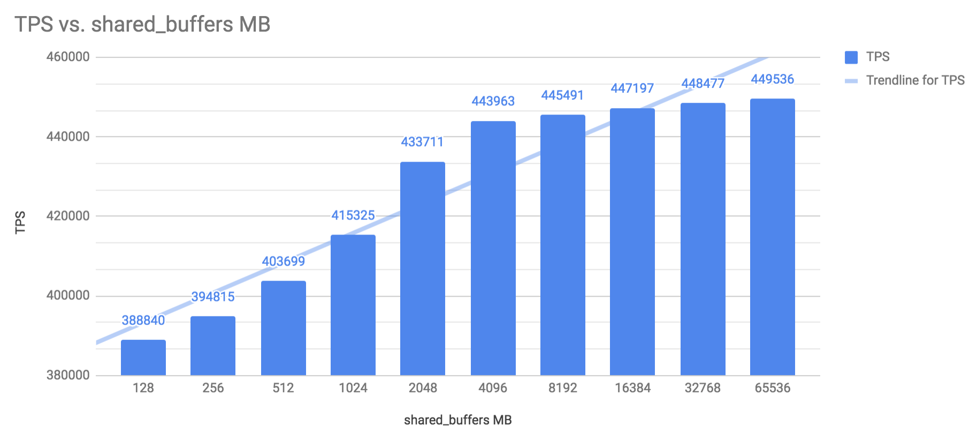
PostgreSQL Tuning / shared_buffer

Slide 9
PostgreSQL Tuning / wal_buffer
PostgreSQL writes its WAL (write ahead log) record into the buffers and then these buffers are flushed to disk.
Bigger value for wal_buffer in case of lot of concurrent connection gives better performance.

Slide 10
PostgreSQL Tuning / effective_cache_size
The effective_cache_size provides an estimate of the memory available for disk caching.
It is just a guideline, not the exact allocated memory or cache size.
It should be large enough to hold most accessed tables, but at the same time small enough to avoid swap.

Slide 11
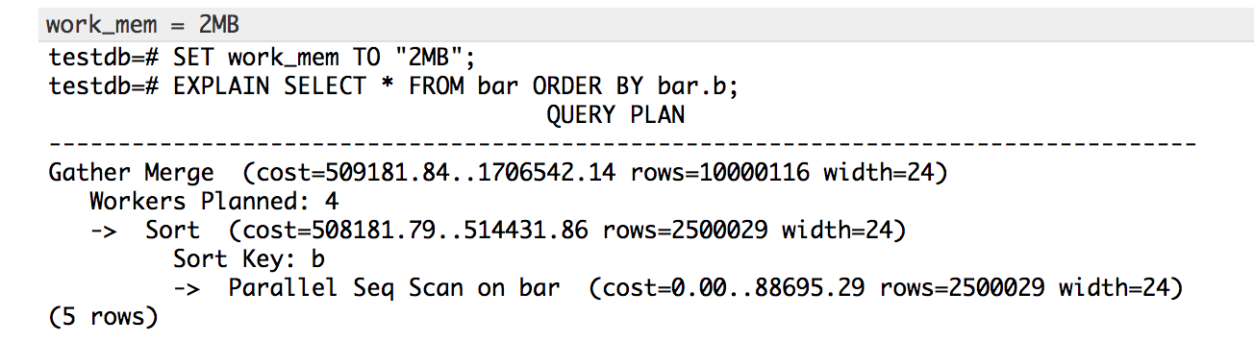
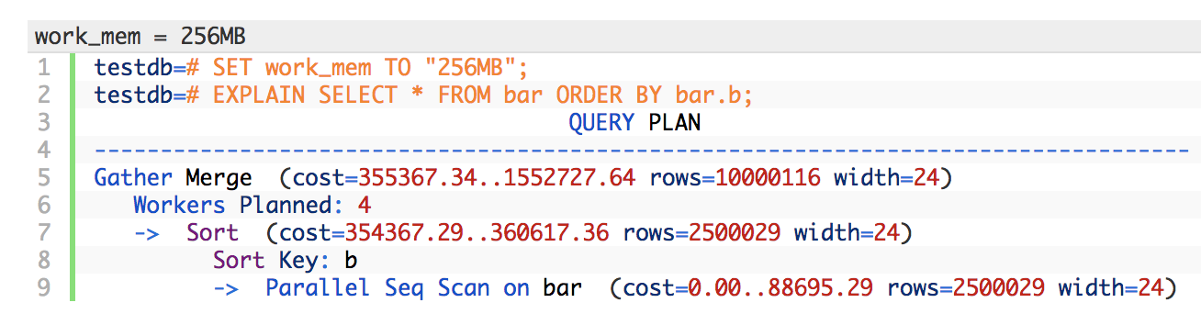
PostgreSQL Tuning / work_mem
This configuration is used for complex sorting.

Slide 12
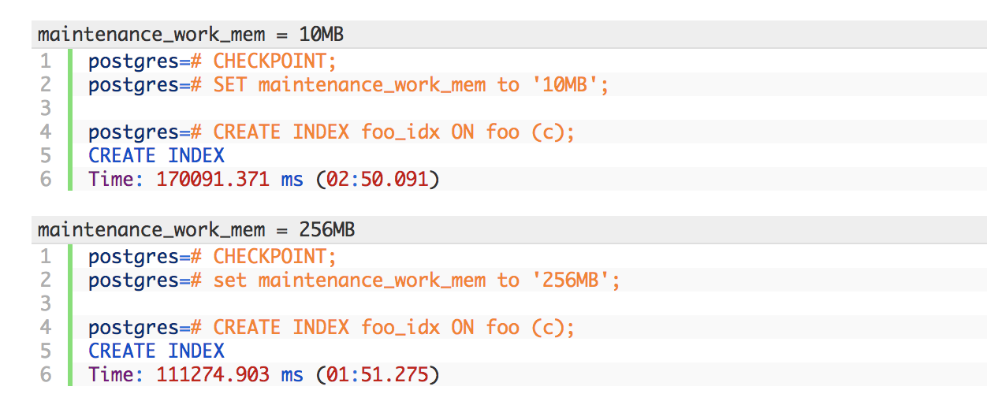
PostgreSQL Tuning / maintenance_work_mem
maintenance_work_mem is a memory setting used for maintenance tasks.
The default value is 64MB.
Setting a large value helps in tasks like VACUUM, RESTORE, CREATE INDEX, ADD FOREIGN KEY and ALTER TABLE.

Slide 13
PostgreSQL Tuning / synchronous_commit
This is used to enforce that commit will wait for WAL to be written on disk before returning a success status to the client.
This is a trade-off between performance and reliability.
Increasing reliability decreases performance and vice versa.

Slide 14
PostgreSQL Tuning / checkpoint_timeout
PostgreSQL writes changes into WAL. The checkpoint process flushes the data into the data files.
More checkpoints have a negative impact on performance.

Slide 15
Linux Kernel Tuning

Slide 16
Linux Page sizes
Typical page size is 4K
Many modern processors support other page sizes
If we consider a server with 256G of RAM:
4K | 67108864
2M | 131072
1G | 256
large/huge pages
Notes:
The address translation logic is also known as page table walking
The page table walk is expensive because it may require multiple memory accesses
Using large pages to improve the effectiveness of the TLB
by increasing the page size we'll have less pages to map

Slide 17
Huge Pages
Linux, by default uses 4K memory pages.
Linux also has Huge Pages and Transparent huge pages.
BSD has Super Pages.
Windows has Large Pages.

Slide 18
Transparent Huge pages
The kernel works in the background (khugepaged) trying to:
"create" huge pages.
Find enough contiguous blocks of memory
Convert them into a huge page
Transparently allocate them to processes when there is a "fit"
Notes:
Transparent Hugepage Support is an alternative means of using huge pages for the backing of virtual memory with huge pages that supports the automatic promotion and demotion of page sizes

Slide 19
Disabling Transparent Huge pages
# cat /proc/meminfo | grep AnonHuge
AnonHugePages: 2048 kB
# ps aux |grep huge
root 42 0.0 0.0 0 0 ? SN Jan17 0:00 [khugepaged]
To disable it:
at runtime:
# echo never > /sys/kernel/mm/transparent_hugepage/enabled
# echo never > /sys/kernel/mm/transparent_hugepage/defrag
at boot time:
GRUB_CMDLINE_LINUX_DEFAULT="(...) transparent_hugepage=never"

Slide 20
Hugepages 1/3
# cat /proc/meminfo
MemTotal: 264041660 kB
...
Hugepagesize: 2048 kB
DirectMap4k: 128116 kB
DirectMap2M: 3956736 kB
DirectMap1G: 266338304 kB
Notes:
"Default" huge page size
DirectMap here is related to TLB use, I'm unsure if accurate though

Slide 21
Hugepage 2/3
# vi /etc/default/grub
GRUB_CMDLINE_LINUX_DEFAULT="hugepagesz=1GB default_hugepagesz=1G”
# update-grub
Generating grub configuration file ...
Found linux image: /boot/vmlinuz-4.4.0-75-generic
Found initrd image: /boot/initrd.img-4.4.0-75-generic
Found memtest86+ image: /memtest86+.elf
Found memtest86+ image: /memtest86+.bin
Done
# shutdown -r now
Notes:
huge page size can only be changed at boot time

Slide 22
Hugepage 3/3 – Enabling / Disabling in PostgreSQL
# vim /etc/postgresql/10/main/postgresql.conf
huge_pages=ON # default is try
# service postgresql restart

Slide 23
Linux Tuning / vm.swappiness
This is another kernel parameter that can affect the performance of the database.
Used to control the swappiness (swapping pages to swap memory into RAM) behavior on a Linux system.
This parameter's can take anything from “0” to “100”, default is 60.
Higher value means more aggressively swap.

Slide 24
Linux Tuning / vm.overcommit_memory and vm.overcommit_ratio
Applications acquire memory and free that memory when it is no longer needed.
But in some cases an application acquires too much memory and does not release it. This can invoke the OOM killer.
Heuristic overcommit, Do it intelligently (default); based kernel heuristics
Allow overcommit anyway
Don’t over commit beyond the overcommit ratio.

Slide 25
Linux Tuning / vm.dirty_background_ratio and vm.dirty_background_bytes
The vm.dirty_background_ratio is the percentage of memory filled with dirty pages that need to be flushed to disk.
Flushing is done in the background.
The value of this parameter ranges from 0 to 100;

Slide 26
Linux Tuning / vm.dirty_ratio / vm.dirty_bytes
The vm.dirty_background_ratio is the percentage of memory filled with dirty pages that need to be flushed to disk.
Flushing is done in the foreground.
The value of this parameter ranges from 0 to 100;

Slide 27
Blogs
Tuning PostgreSQL Database Parameters to Optimise Performance.
https://www.percona.com/blog/2018/08/31/tuning-postgresql-database-parameters-to-optimize-performance/
Tune Linux Kernel Parameters For PostgreSQL Optimisation
https://www.percona.com/blog/2018/08/29/tune-linux-kernel-parameters-for-postgresql-optimization/

Slide 28

?
“Poor leaders rarely ask questions of themselves or others. Good leaders, on the other hand, ask many questions. Great leaders ask the great questions.”
Michael Marquardt author of Leading with Questions

